Slide 1


Priyadarshini Engineering College Department of Master of Computer Applications Name : SUGESH NANDU D Reg.No: 511923622045 MC4411 PROJECT WORK Bike Rental with Exploring System
SUPERVISOR
Ms. Jeevalakshmi, B.sc.,MCA.,
Assistant Professor,
Department of Master of Computer Applications ,
Priyadarshini Engineering College.
Vaniyambadi.
HEAD OF THE DEPARTMENT
Dr.Manikandan G,M.Sc.,B.Ed.,M.Phil.,Ph.D.,
Head of the Department,
Department of Master of Computer Applications,
Priyadarshini Engineering College.
Vaniyambadi.
Anna University, Chennai

Slide 2
Contents
ABSTRACT
INTRODUCTION
PROBLEM DEFINITION
OBJECTIVE OF THE PROJECT
EXISTING SYSTEM
PROPOSED SYSTEM
METHODOLOGY
HARDWARE REQUIREMENTS
SOFTWARE REQUIREMENTS
ARCHITECTURE DIAGRAM
ER DIAGRAM
DATAFLOW DIAGRAM
UML DIAGRAM
CLASS DIAGRAM
ACTIVITY DIAGRAM
SEQUENCE DIAGRAM
DATABASE DESCRIPTION
MODULE DESCRIPTION
CONCLUSION
SCOPE FOR FUTURE ENHANCEMENT
SCREEN SHOTS
REFERENCES
Anna University, Chennai

Slide 3
ABSTRACT
The Bike Rental with Explore system is a web-based platform designed to provide a seamless bike rental experience while helping users explore tourist destinations. Developed using HTML, CSS, JavaScript, and Bootstrap, PHP and MYSQL the system offers a responsive and user-friendly interface. It features an interactive location map, allowing users to discover popular tourist spots and locate nearby rental stations. This innovative approach enhances travel convenience and promotes eco- transportation. The two key modules: User Module and Admin Module. Users can register, browse bikes, check rental pricing, and book bikes online. Users can register, browse bikes, check rental pricing, and book bikes online. A Online Invoice system ensures hassle-free Admin panel , Users can also leave reviews and ratings, helping others make informed.
Anna University, Chennai

Slide 4
INTRODUCTION
This web-based platform is designed with user experience in mind, offering a responsive interface and an interactive map to help users locate nearby rental stations and discover popular attractions. The system is structured into two main modules: the User Module and the Admin Module. The User Module allows individuals to register, browse available bikes, view rental pricing, and make online bookings with ease. The Admin Module provides tools for administrators to manage bike listings, monitor bookings, and update tourist destination information. By promoting bicycle usage for travel, the system supports sustainable tourism and offers a smarter, eco-friendly alternative for both urban commuters and tourists.
Anna University, Chennai

Slide 5
PROBLEM DEFINITION
The rising demand for convenient and eco-friendly transportation in tourist areas highlights the need for an efficient bike rental system. Traditional methods are often manual, time-consuming, and lack transparency, making it difficult for tourists to find and book bikes easily. There is no centralized platform to view available bikes, compare prices, or locate nearby rental stations. The absence of real-time navigation and user feedback also limits satisfaction and decision-making.
Anna University, Chennai

Slide 6
OBJECTIVE OF THE PROJECT
To provide a user-friendly, web-based platform for easy and efficient bike rentals in tourist destinations. To enable users to browse, compare, and book bikes online with real-time availability and pricing information. To integrate an interactive map that helps users locate nearby rental stations and explore popular tourist attractions. To support sustainable and eco-friendly travel by encouraging the use of bicycles over fuel-based transport. To offer an admin dashboard for managing bikes, monitoring bookings, and updating destination and pricing details. To improve user experience through features like registration, booking history, and feedback/review systems.
Anna University, Chennai

Slide 7
EXISTING SYSTEM
The bike rental system offers a smooth experience for both users and administrators. Users can register, log in, browse bikes, make bookings, manage their profiles, view rental history, and share feedback through testimonials. The admin panel allows administrators to manage bike listings, monitor bookings, and handle user accounts efficiently. This organized structure ensures proper maintenance and smooth operation of the platform. While the system covers essential features, it can be enhanced by adding advanced filters, rental analytics, and data export capabilities. These improvements would increase efficiency, improve user satisfaction, and provide better insight into rental trends for administrators.
Anna University, Chennai

Slide 8
PROPOSED SYSTEM
The proposed bike rental system aims to significantly enhance the current platform by improving its usability, efficiency, and overall user experience. It will retain core features such as user registration, bike listings, booking management, profile handling, and testimonial posting, while introducing new functionalities to streamline navigation and management. The user panel will feature an improved rental history section, allowing users to easily track their past and on-going bookings. The admin panel will also see upgrades, with advanced tools for managing bikes, monitoring users, and supervising bookings. Key features like filtered booking organization, detailed rental analytics, and data export options will help administrators make more informed decisions and manage operations more efficiently.
Anna University, Chennai

Slide 9
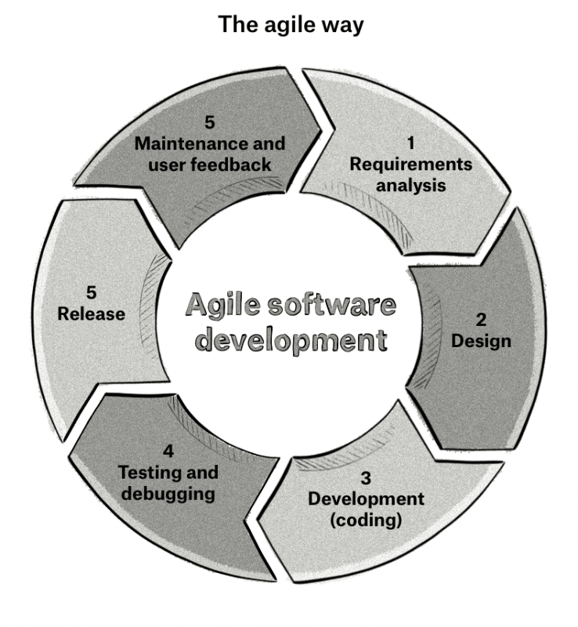
METHODOLOGY
The Agile Model is a software development approach that focuses on iterative progress, flexibility, and collaboration. It promotes continuous feedback and adaptation to changing requirements, making it ideal for projects where customer needs evolve over time.
Anna University, Chennai

Slide 10
HARDWARE REQUIREMENTS
processor : AMD A6
Hard Disk :100GB
Resolution :1366 ×768(1920 ×1080)Recommended
Anna University, Chennai

Slide 11
SOFTWARE REQUIREMENTS
Frontend: HTML, CSS, JavaScript
Backend: PHP, MySQL
software: VS code, XAMMP, Sublime Text
Anna University, Chennai

Slide 12
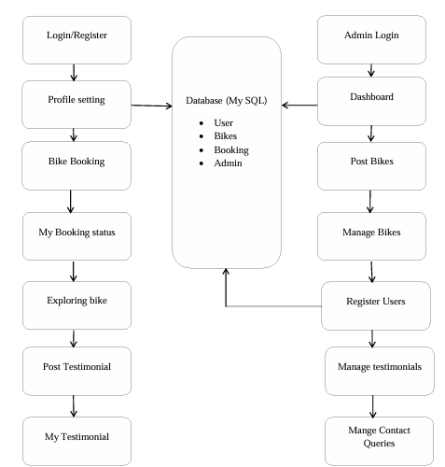
ARCHITECTURE DIAGRAM
Login/
Register
Admin Login
Database
User
Bikes
Admin
Profile Setting
Dashboard
Bike Booking
Post Bikes
My Booking Status
Manage bike
Exploring Bikes
Register Details
Login/
Register
Manage Testimonial
My
Testimonial
Manage Queries
Anna University, Chennai

Slide 13
ER DIAGRAM
User_Name
User_id
Booking_id
Bike details
Status
Phone No
Bike details
update
DOB
User Details
Bike Manage Details
Address
Admin
Email id
Password
User
user Manage Details
Bike_id
Bike Details
Bike Name
Contact
Review
Bike Booking
Bike Model
User Dashboard
Bike Pickup
Bike Price
Booking
Select_bike
Pick up
Start Date
End Date
Bike Book
Anna University, Chennai

Slide 14
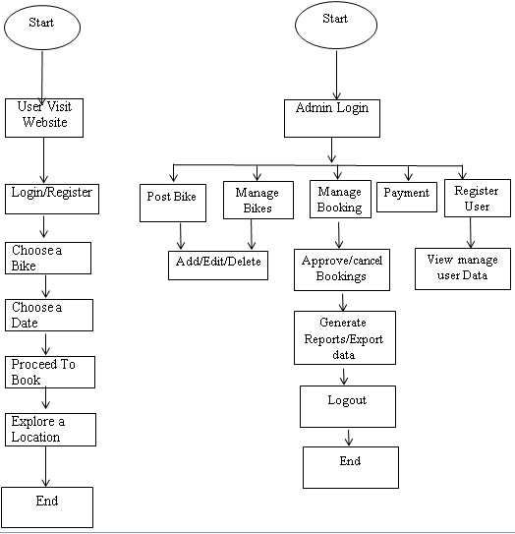
DATAFLOW DIAGRAM
Anna University, Chennai

Slide 15
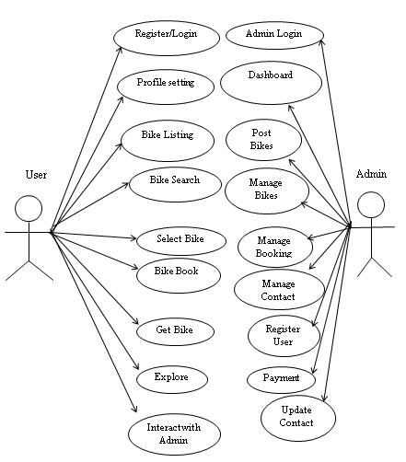
UML DIAGRAM
USECASE DIAGRAM
Anna University, Chennai

Slide 16
ACTIVITY DIAGRAM
­­
Data User
Admin
Register/Login
Login
User detail
Profile setting
Booking Details
Bike Listing
Bike Managing
Dashboard data Managing
Bike Booking
Explore
Confirm
Managing Booking
Anna University, Chennai

Slide 17
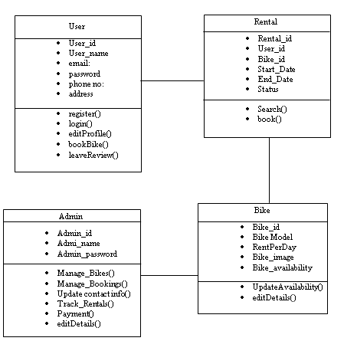
CLASS DIAGRAM
Anna University, Chennai

Slide 18
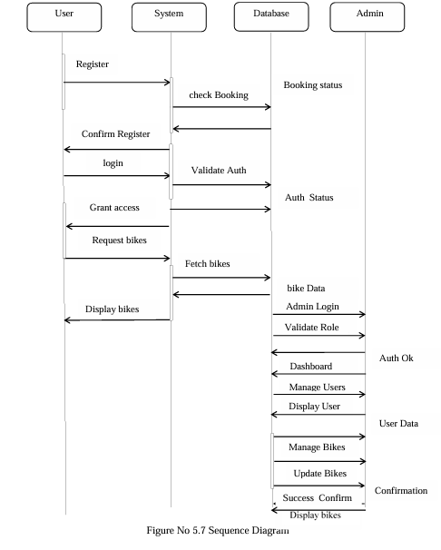
SEQUENCE DIAGRAM
Anna University, Chennai

Slide 19
Table Name: User Register
Serial no: | Field Name | Data Type | Constraints | Description
1 | User_id | Int | primary key | Unique ID for user
2 | Full name | Varchar (100) | Not Null | username
3 | Email id | Varchar (255) | Not Null | A valid email address used for login
4 | password | Varchar (100) | Not Null | Hashed password
5 | Contact no | Int | Not Null | User contact no
6 | Address | Varchar (100) | Not Null | Users current address including, pin-code
7 | Date of Birth | Date | Not Null | used to calculate age
Anna University, Chennai

Slide 20
Table Name: User Login
Serial no: | Field Name | Data Type | Constraints | Description
1 | User_Id | Int | Primary Key | Unique ID for user
2 | User Name | Varchar (100) | Not Null | Username
3 | User Password | Varchar (255) | Not Null | Hashed password
Anna University, Chennai

Slide 21
Table Name: Profile setting
Table No: 3. Profile Setting
Serial no: | Field Name | Data Type | Constraints | Description
1 | User_Id | Int | Primary key | Unique ID for user
2 | User Name | Varchar (100) | Not Null | Username
3 | Contact no | Int | Not Null | User contact no
4 | Address | Varchar (100) | Not Null | Users current address including, pin-code
5 | Date of Birth | Date | Not Null | use to calculate age
6 | License No | Int | Not Null | License is use for Proof
7 | Aadhar No | Int | Not Null | Aadhar is use to user verification
Anna University, Chennai

Slide 22
Table Name:Bike Booking
Serial no: | Field Name | Data Type | Constraints | Description
1 | Bike_Id | Int | Primary Key | Unique ID for user
2 | User name | Varchar (100) | Not Null | Username
3 | Bike name | String | Not Null | Bike name identify
4 | From date | Date | Not Null | Start date of the bike rental
5 | To date | Date | Not Null | End date of bike rental
6 | Status | String | Not Null | Current status of the booking
Anna University, Chennai

Slide 23
Table Name 5. Feedback
Serial no: | Field Name | Data Type | Constraints | Description
1 | Username | Varchar(100) | Not Null | username
2 | Feedback | Text | Not Null | User Review
Anna University, Chennai

Slide 24
Table Name: Admin Login
Serial no: | Field Name | Data Type | Constraints | Description
1 | Admin Id | Int | Primary Key | Unique ID for admin
2 | Admin Name | Varchar(100) | Not Null | Admin username
3 | Admin Password | Varchar(255) | Not Null | Hashed password
Anna University, Chennai

Slide 25
Table Name:Bike Update table
Serial no: | Field Name | Data Type | Constraints | Description
1 | Bike_id | Int | Primary Key | Unique bike ID
2 | Bike Title | Varchar (150) | Not Null | Bike model name
3 | Bike Brand | Varchar(150) | Not Null | Associated brand
4 | Price Per Day | Decimal | Not Null | Rental price per day (₹ INR)
5 | Fuel Type | Varchar (50) | Not Null | Petrol/Diesel/CNG
6 | Model Year | Year | Not Null | Manufacturing year
7 | Vimage1 | Varchar(225) | Not Null | Image file name
8 | Description | Text | Not Null | Bike details
Anna University, Chennai

Slide 26
Table Name :User Details
Serial no: | Field Name | Data Type | Constraints | Description
1 | User_Id | Int | Primary | Unique user ID
2 | Full Name | Varchar (150) | Not Null | User's full name
3 | Email Id | Varchar (150) | Not Null | User email
4 | Password | Varchar (255) | Not Null | Hashed password
5 | Contact No | Varchar (225) | Not Null | Mobile number
6 | License No | Int | Not Null | License is use for Proof
7 | Aadhar No | Int | Not Null | Aadhar is use to verification
6 | Reg Date | Not Null | Not Null | Registration date
Anna University, Chennai

Slide 27
Table Name: Bike Booking Details
Serial no: | Field Name | Data Type | Constraints | Description
1 | Bike_id | Int | Primary | Unique booking ID
2 | User Id | Int | Foreign key | Who booked?
3 | Booking Date | Date | Not Null | Bike Booking Date
3 | From Date | Date | Not Null | Start date of rental
4 | To Date | Date | Not Null | End date of rental
5 | Total Amount | Decimal | Not Null | Total cost (₹ INR)
6 | Status | Enum | Not Null | Booking status
7 | Bike Receive Date | Date | Not Null | Bike return date
Anna University, Chennai

Slide 28
Table Name: Online Invoice Details
Serial no: | Field Name | Data Type | Constraints | Description
1 | Invoice No | Int | Primary | Unique booking ID
2 | Invoice Date | Int | Foreign key | Who booked?
3 | Customer Details | Varchar | Not Null | Bike Booking Date
3 | Bike Name | Varchar | Not Null | Name of the Bike
4 | Bike Price | Int | Not Null | Price of the Bike
5 | Days | Int | Not Null | Days of the Rent
6 | GST | Decimal | Not Null | GST for Rent
7 | Total Amount | Decimal | Not Null | Total cost (₹ INR)
Anna University, Chennai

Slide 29
Table Name:Contact Queries Table
Serial no: | Field Name | Data Type | Constraints | Description
1 | User_id | INT | Primary | Query ID
2 | Name | Varchar (150) | Not Null | User name
3 | Email Id | Varchar (150) | Not Null | Email of sender
4 | Message | Text | Not Null | User message
5 | Status | Enum | Not Null | Query status
Anna University, Chennai

Slide 30
MODULE DESCRIPTION
User Module
The User Module allows individuals to register, log in, and manage their accounts.
Register/Login: Create an account and access the system securely.
Browse Bikes : View available bikes
Book Bikes:, check prices and features, and make bookings.
Manage Profile: Update personal information like name, email, phone, address, license, etc.
Rental History & Contracts: Track previous bookings and view rental agreements.
Explore Tourist Spots: Use maps to discover popular destinations and routes.
Post Testimonials: Share feedback and experiences.
Anna University, Chennai

Slide 31
MODULE DESCRIPTION
Admin Module
The Admin Module provides tools to oversee and manage the platform. Admins can:
Admin Login: Securely access the admin dashboard.
Dashboard View: Monitor user activity, bookings, and rental stats.
Manage Bikes: Add, update, or remove bike listings.
User Management: Approve users, manage accounts, and resolve issues.
Booking Management: View, confirm, or cancel user bookings.
Contract Queries: Handle user concerns about rental terms or payments.
Subscription Management: Manage newsletter subscribers and send updates.
Anna University, Chennai

Slide 32
CONCLUSION
The Bike Rental with Explore system offers a smart and eco-friendly solution for modern transportation needs. By integrating bike rentals with tourism exploration and route navigation, it not only promotes sustainable travel but also enhances the overall user experience. The inclusion of a robust admin panel ensures efficient management of bikes, bookings, and user data. This system is a valuable tool for both tourists and locals, making travel more accessible, enjoyable, and organized. Additionally, the system’s intuitive interface ensures ease of use across all user levels. Real-time tracking and route guidance add extra convenience for users on the move. Overall, the platform bridges technology with tourism to provide a seamless rental and exploration experience.
Anna University, Chennai

Slide 33
FUTURE ENHANCEMENT
To further improve the functionality and user experience of the Bike Rental with Explore system, several future enhancements can be implemented. Developing a dedicated mobile application for Android and iOS platforms will allow users to book bikes and navigate routes more conveniently on the go. Integrating real-time GPS tracking will enhance navigation and security by allowing users and admins to monitor bike locations. A dynamic pricing system based on demand, time, and season can optimize resource utilization and revenue. The addition of AI-based recommendation features will personalize suggestions for bikes, routes, and tourist destinations. Multi-language support will broaden accessibility for users from various regions.
Anna University, Chennai

Slide 34
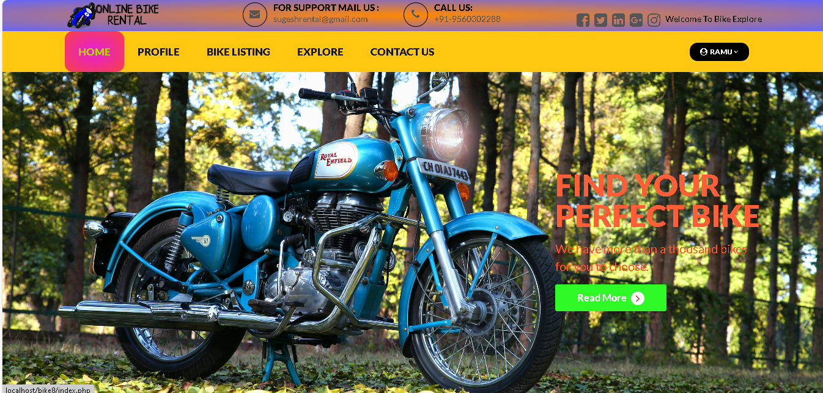
SCREEN SHOTS
Home
Anna University, Chennai

Slide 35
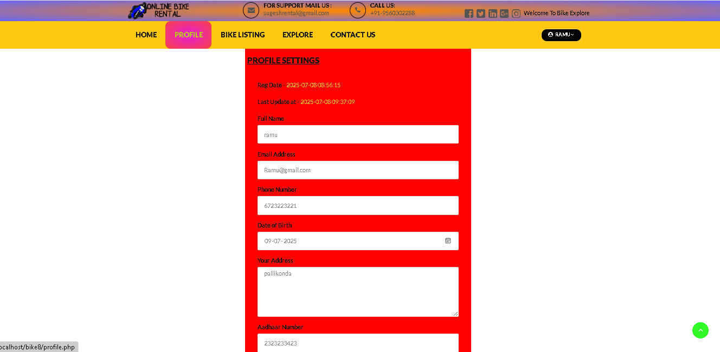
Profile
Anna University, Chennai

Slide 36
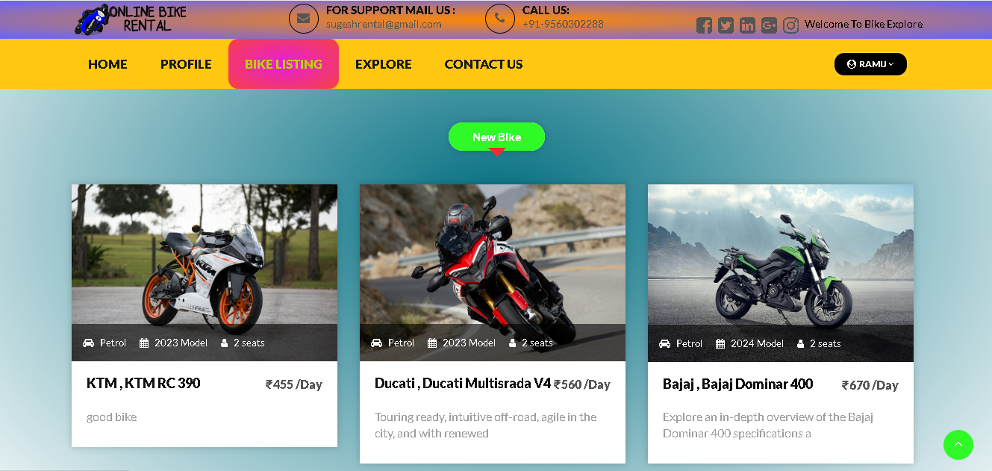
Bike Listing
Anna University, Chennai

Slide 37
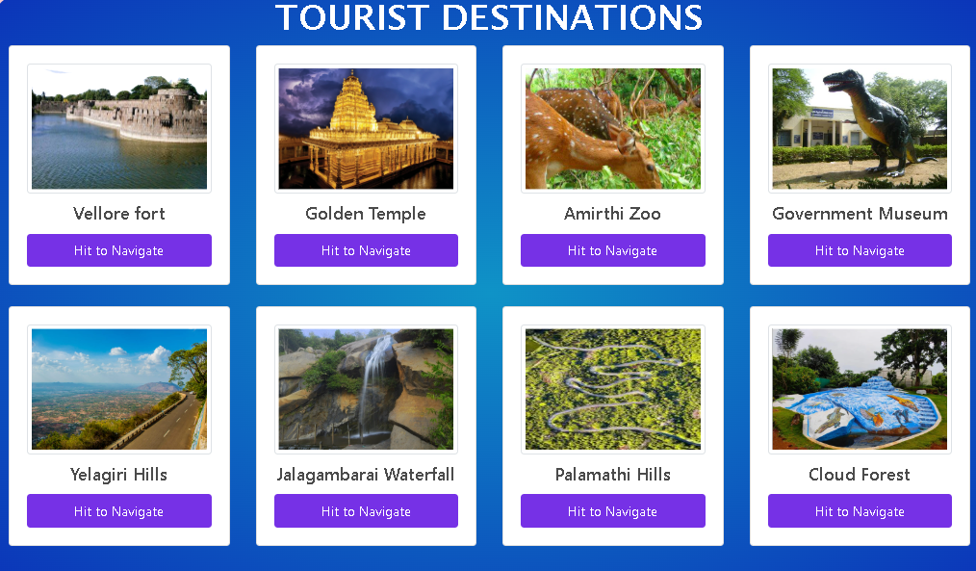
Location Exploration
Anna University, Chennai

Slide 38
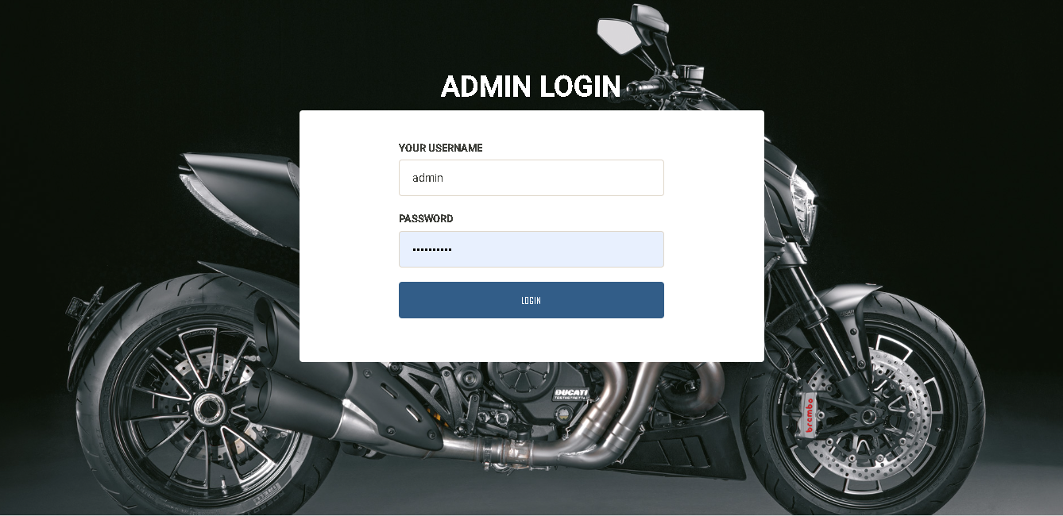
Admin Login
Anna University, Chennai

Slide 39
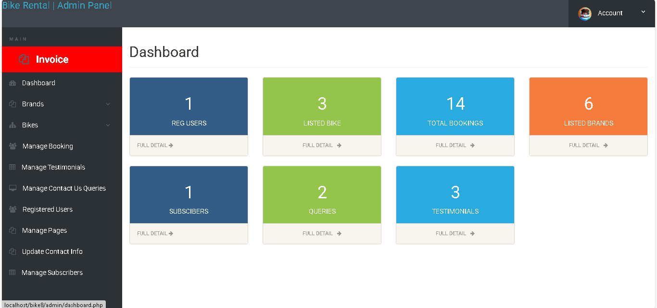
Dashboard
Anna University, Chennai

Slide 40
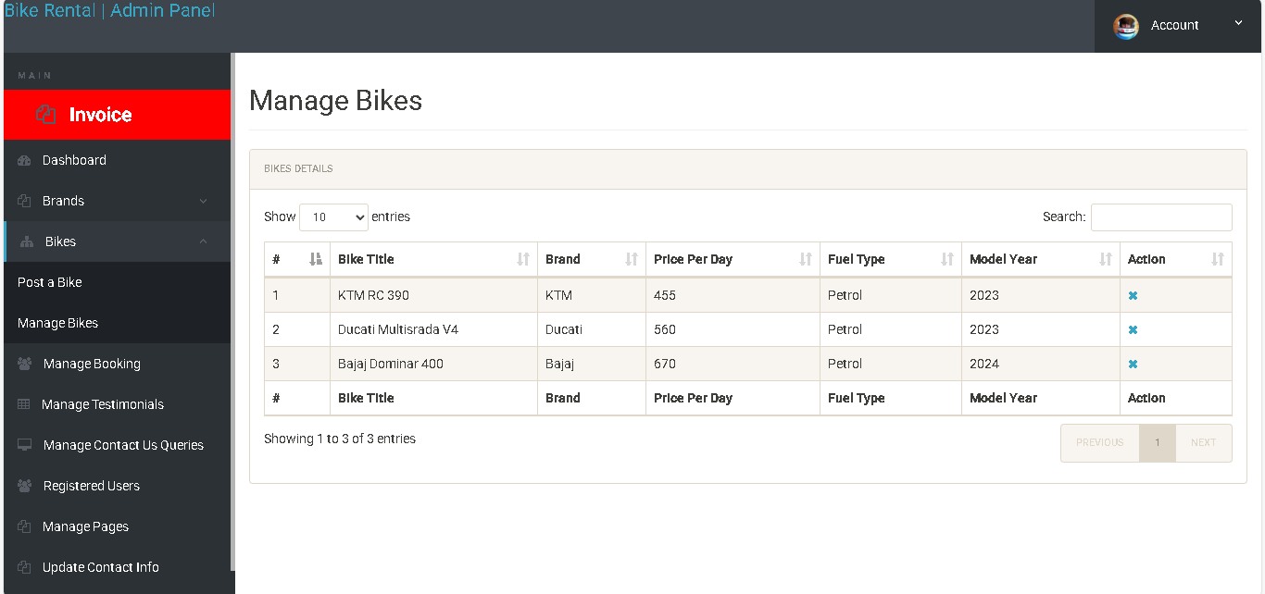
Manage Bikes
Anna University, Chennai

Slide 41
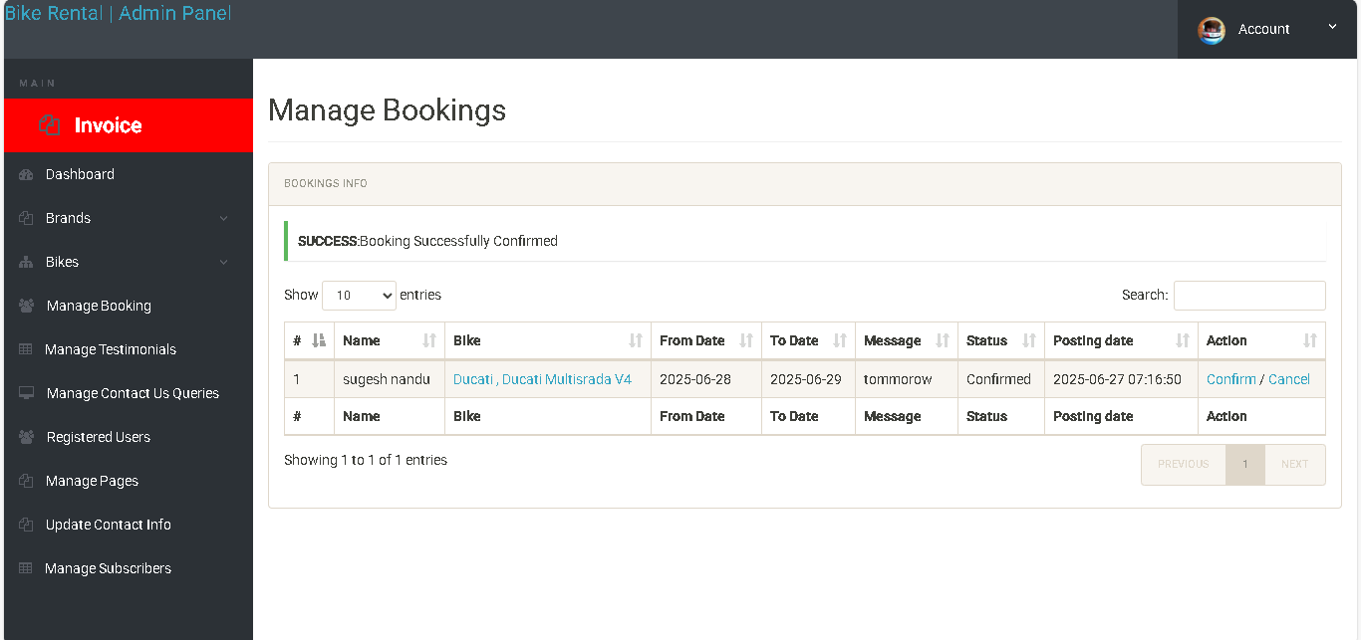
Manage Bookings
Anna University, Chennai

Slide 42
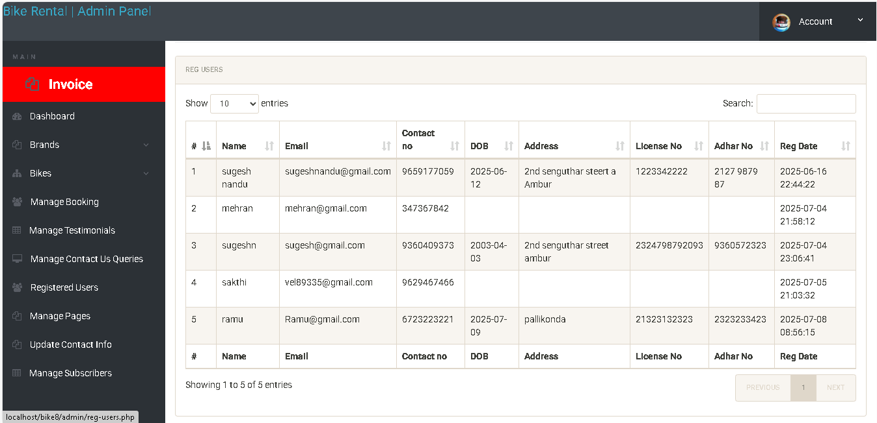
Manage Users
Anna University, Chennai

Slide 43
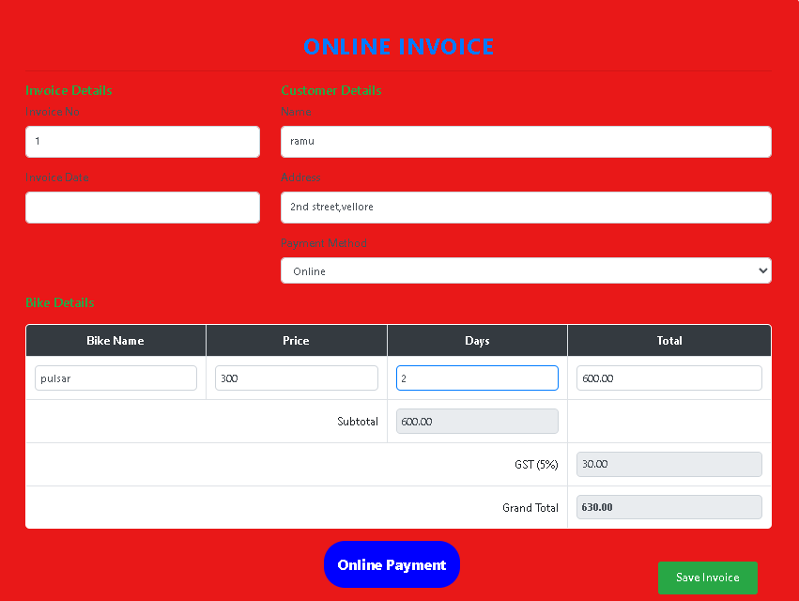
Invoice
Anna University, Chennai

Slide 44
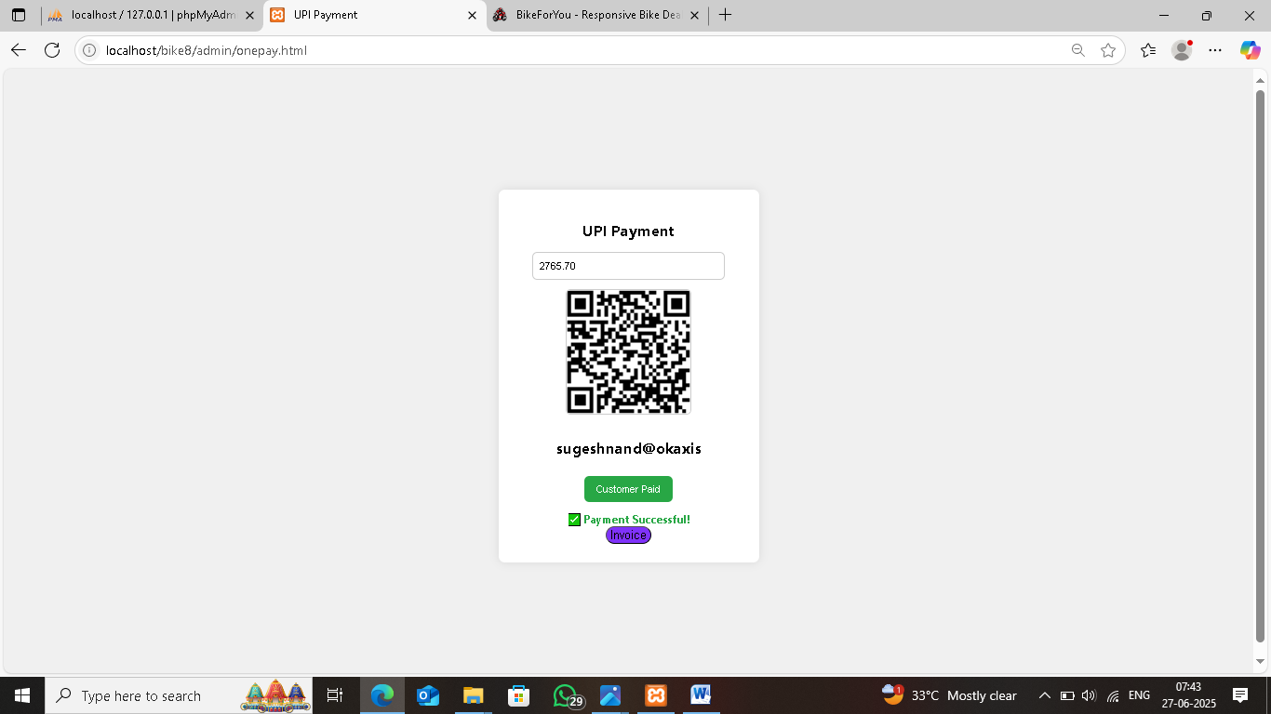
Online Payment
Anna University, Chennai

Slide 45
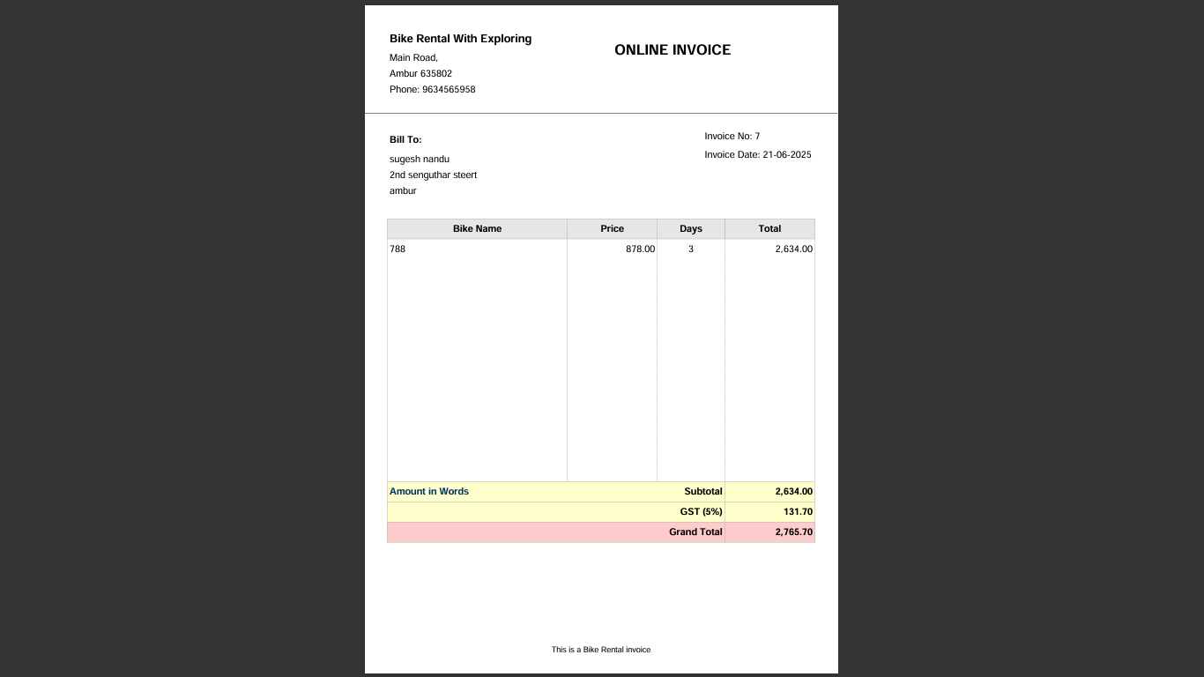
Invoice Print
Anna University, Chennai

Slide 46
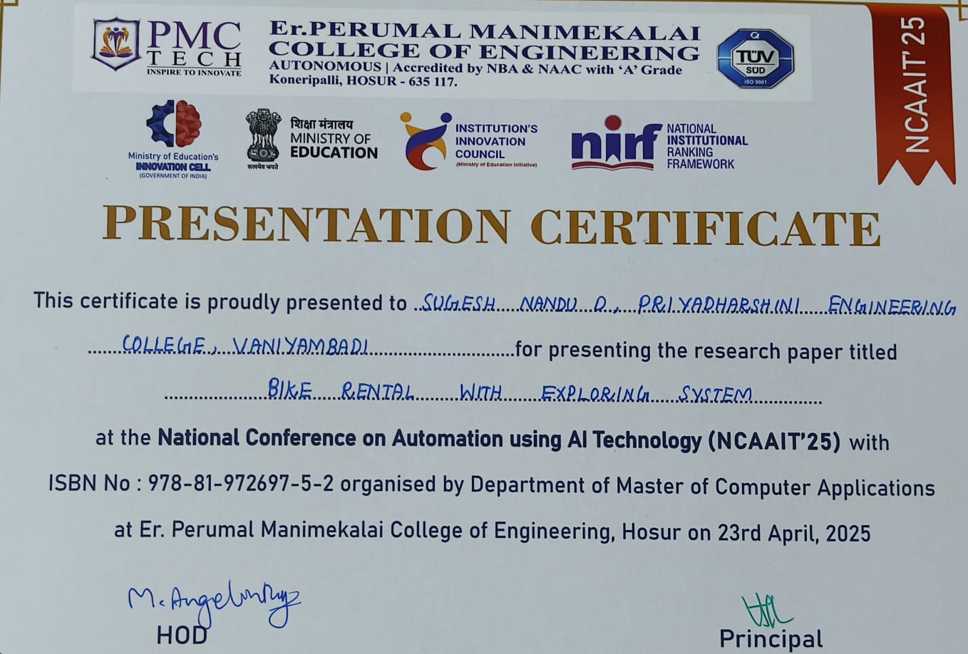

Slide 47
REFERENCES
Bike Rental with Exploring System
Web Reference
[1] https://www.w3schools.com
[2] https://www.fullstack.com
[3] https://dev.mysql.com/doc/
[4] https://www.w3schools.com/php/
Book Reference
[1] Sommerville, Ian. Software Engineering (10th Edition). Pearson Education, 2015.
[2] Pressman, Roger S., and Maxim, Bruce R. Software Engineering: A Practitioner’s Approach (8th Edition). McGraw-Hill Education, 2014.
[3] Welling, Luke, and Thomson, Laura. PHP and MySQL Web Development (5th Edition). Addison-Wesley, 2016.
Anna University, Chennai

Slide 48
Thank You

